Slide 1
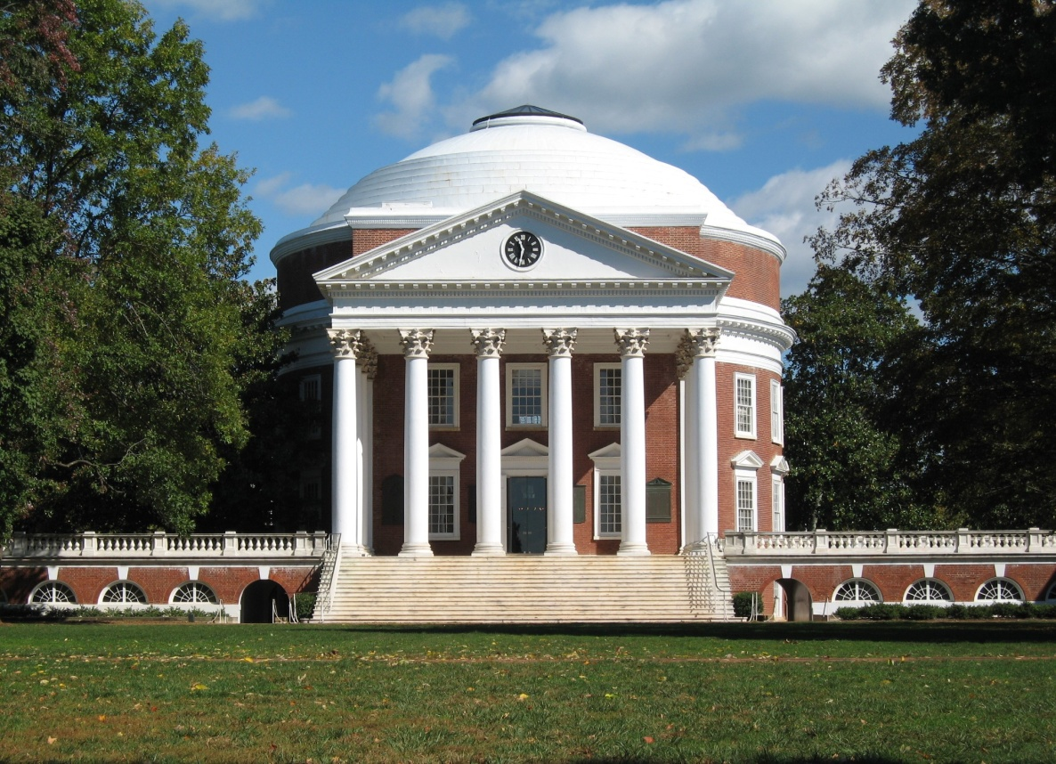
Private Editing Using
Untrusted Cloud Services
Yan Huang and David Evans
University of Virginia
http://MightBeEvil.com

Slide 2






Motivation
To take advantage of existing cloud services without revealing private data to untrusted servers.
We expect a solution that
  is easy to deploy
  and results in minimal negative interference with existing functionalities
Notes:
Existent service model usually require users to fully trust the server, which is sometimes ungrounded.
This “full-trust” relation can sometimes be ungrounded, causing lose of user data control.
It hinders more wide-spread of some web applications.

Slide 3
Observation:
Server Doesn’t Need Data
Many cloud applications perform most data-dependent computation on the client:
  Reduce server load
  Reduce latency
Computation needed at server-side:
Protecting proprietary algorithms
Greater computing power
Large data needed
Notes:
Improved user experience
Rich Internet Applicaitons

Slide 4
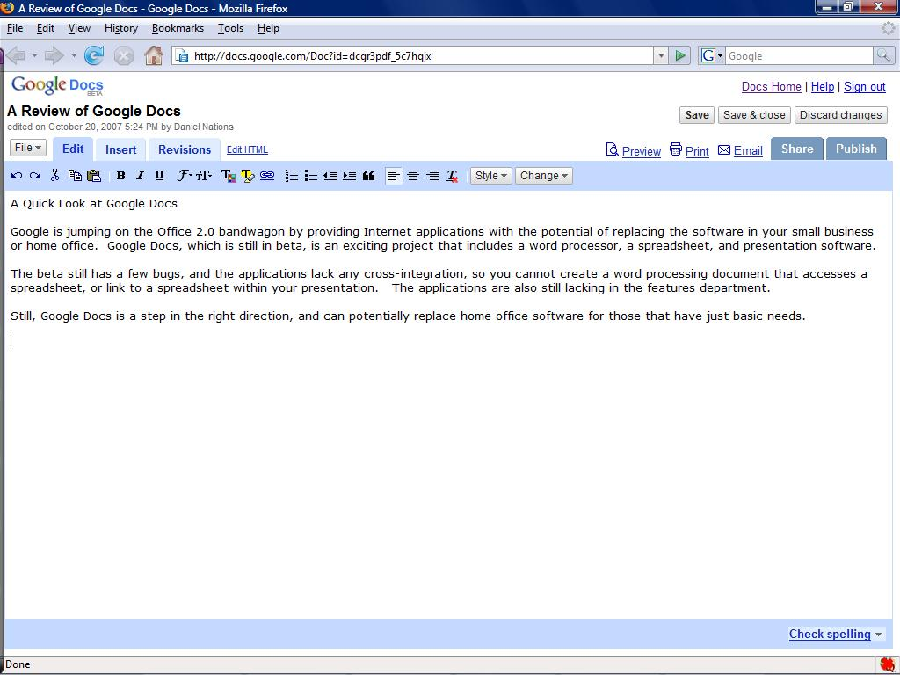
Developed a Firefox extension to enable private editing using Google Documents.

Slide 5

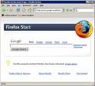


Typical Threat Model
Server is not trusted, has
full access to user data.
Browser is not
compromised

Slide 6
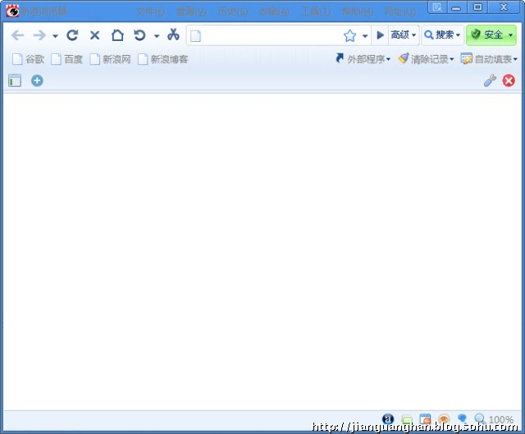



Design Choices
Client
Server
Add-on
Proxy
User JS
Notes:
Proxy:
Need to trust the proxy
Unable to handle TLS encrypted traffic
Largely for corporate use
User JS:
No API for intercepting net traffic in general
No preemptive execution (Greasemonkey)
Require deep understanding of client code
Add-on:
Trusted browser and extension
Easy to deploy at individual user granularity
Orthogonal to TSL encryption

Slide 7
Protocol Without Extension
Client
Server
(1) Open document
http://docs.google.com/Doc?docid=001
<html>...<script>var DOC_Content=“...cloudy...”</script>…</html>
(2) Save “sunny”
http://.../RawDocContents?docContents=“sunny”
docid=001
“sunny”
docid=001
“cloudy”
ACK:{contentFromServer:””,contentFromServerHash:0}

Slide 8
Protocol Without Extension
Client
Server
(3) Save “sunshine”
.../RawDocContents?contentIsDelta=true&delta=“=3 +shi =1 -1 +e”
ACK:{contentFromServer:””,contentFromServerHash:0}
docid=001
“sunny”
docid=001
“sunshine”
Notes:
sunny
sunshine

Slide 9
Protocol With Extension
Client
Extension
Server
(1) Open document
…/Doc?docid=001
…/Doc?docid=001
Dec
<html> “...E(‘cloudy’)...” </html>
<html> “... cloudy...” </html>
(2) Save “sunny”
…/RawDocContents?docContents=sunny
Enc
RawDocContents?docContents=E(‘sunny’)
docid=001
E(‘sunny’)
docid=001
E(‘cloudy’)
ACK:{contentFromServer:””,contentFromServerHash:0}
ACK:{contentFromServer:””,contentFromServerHash:0}

Slide 10
Protocol With Extension
Client
Extension
Server
(3) Save “sunshine”
IncE
.../RawDocContents?...&delta=“=3 +shi =1 -1 +e”
…/RawDocContents?...&delta=IncE(delta)
ACK:{contentFromServer:””,contentFromServerHash:0}
ACK:{contentFromServer:””,contentFromServerHash:0}
docid=001
E(‘sunny’)
docid=001
E(‘sunshine’)

Slide 11
Incremental Encryption
key generation algorithm
encrypt whole message m
decrypt ciphertext c
given a key k, an edit operation op, previous message m, and previous ciphertext c, compute an updated ciphertext c’.
[BKY01] – Buonanno, Katz, and Yung. Fast Software Encryption 2001
Notes:
Incrementality offers efficiency in computing updated encryptions.

Slide 12
Privacy Only Mode
Trapdoor psuedorandom permutation
Random numbers
Document segments
Concatenation
Trapdoor psuedorandom permutation
Random numbers
Document segments
Concatenation
Notes:
Incrementality for Insertion/deletion
Note the ciphertext blow-up

Slide 13
Multiple Characters per Block
Motivation: reduce the ciphertext blow-up
Challenge: the index of each character will change so that naïve implementation won’t work

Slide 14
IndexedSkipList
0
0
0
Head
Nil

Slide 15
IndexedSkipList
Insert(0,“abc”);
3
3
0
3
Head
abc
Nil

Slide 16
IndexedSkipList
Insert(0,“abc”);
Insert(3,“1234”);
7
3
4
0
3
4
Head
abc
1234
Nil

Slide 17
IndexedSkipList
Ins(0,“abc”);
Ins(3,“1234”);
Del(2, 3);
4
2
2
0
2
2
Head
ab
34
Nil

Slide 18
Security Analysis
Server knows the document ciphertext
Can infer the length of original document
Knows editing positions and edit operation types
Can deny service

Slide 19

Extreme Threat Model
Server controls client’s
application content software.

Slide 20
Security Analysis
Covert Channels such as timing or delta
Using obfuscated protocol
Dynamically generated client/server protocols
-1 +Cal =1 +fo =1 -2 =3
-8 +California
Virginia
California
-5 +Califor =3

Slide 21
Functional Evaluation
Basic editing functions are supported
Features disrupted:
  Translation
  Spell checking
  Drawings
  Export
  Collaboration

Slide 22
Performance Evaluation
Micro-Benchmarks
 | Average Time (per char)
encryption | .091 ms
decryption | .085 ms
transform delta | .110 ms
Microbenchmark of privacy-and-integrity mode
(avg. of 1000 tests)

Slide 23
Macro-Benchmarks

Slide 24
Conclusion
Editing encrypted data can be practical
Practical secure computation under relaxed security definitions can be very useful
Would be a very challenging problem should the service provider chooses not to cooperate
Download from: www.MightBeEvil.com/securedocs

